Slide 1
Field Effect Transistors-FET

Slide 2
Introduction
IN THIS LECTURE WE WILL LEARN:
General overview on FET transistor and its types.
The physical structure of the MOS transistor and how it works.
How the voltage between two terminals of the transistor control the current that flows through the third terminal, and the equations that describe these current-voltage characteristics.
How the transistor can be used to make an amplifier, and how it can be used as a switch in digital circuits.

Slide 3
Introduction
The invention of the BJT has brought a great twist in the modern era of semiconductor technology. This device, along with its field-effect counterpart, known as the field-effect transistor (FET), has had a huge impact on virtually every area of modern life.
Practical field-effect transistors were first made in the form of JFET in 1953 and MOSFET in 1963.
Two main types of FET:
- JFET –Junction field effects transistor
MOSFET – Metal oxide semiconductor field effect transistor
D-MOSFET ~ Depletion MOSFET
E-MOSFET ~ Enhancement MOSFET

Slide 4
Differences between FET & BJT
 | Field Effect Transistor (FET) | Bipolar Junction Transistor (BJT)
1 | Unipolar Current depends only on one type of carriers | Bipolar Current depends on both electrons and holes
2 | Voltage controlled device | Current controlled device
3 | Very high input impedance | Low input impedance
4 | Simpler in fabrication and occupies less space in integrated form | occupies large space in integrated form
5 | Low voltage gain High current gain | High voltage gain Low current gain
6 | Easily damaged | Robust

Slide 5
Similarities between FET & BJT
Similarities:
• Amplifiers
• Switching devices
• Impedance matching circuits

Slide 6
JFET Construction
There are two types of JFETs
n-channel
p-channel
The n-channel is more widely used.
There are three terminals:
Drain (D) and Source (S) are connected to the n-channel through an ohmic contact
Gate (G) is connected to the p-type material
JFET has two p-n junctions under no-bias conditions.

Slide 7
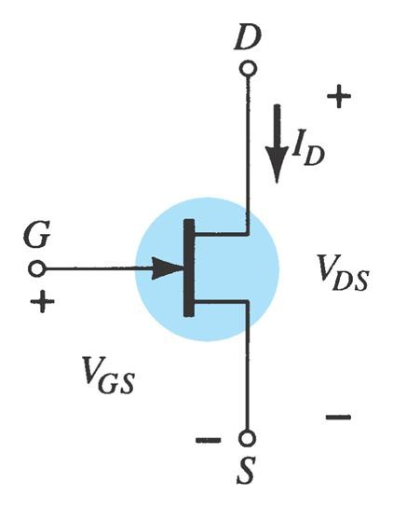
N-Channel JFET Symbol

Slide 8
JFET Operation: The Basic Idea
JFET operation can be compared to a water spigot.
The source of water pressure is the accumulation of electrons at the negative pole of the drain-source voltage.
The drain of water is the electron deficiency (or holes) at the positive pole of the applied voltage.
The control of flow of water is the gate voltage that controls the width of the n-channel and, therefore, the flow of charges from source to drain.

Slide 9
Junction field effect transistor (JFET)
N-Channel JFET Circuit Layout:
Drain
n
Gate
p
p
^{V}DD
^{V}GG
Source
Voltage controlled – the gate voltage controls the drain current

Slide 10
JFET Operating Characteristics
There are three basic operating conditions for a JFET:
V_{GS} = 0 V (zero), V_{DS} increasing to some positive value
V_{GS} < 0 V (negative), V_{DS} at some positive value
Ohmic region: Voltage-controlled resistor

Slide 11
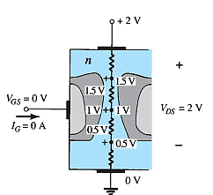
JFET Operating Characteristics: V_{GS} = 0 V
Three things happen when V_{GS} = 0 and V_{DS} is increased from 0 to a more positive voltage
The depletion region between p-gate and n-channel increases as electrons from n-channel combine with holes from p-gate.
Increasing the depletion region, decreases the size of the n-channel which increases the resistance of the n-channel.
Even though the n-channel resistance is increasing, the current (I_{D}) from source to drain through the n-channel is increasing. This is because V_{DS} is increasing.
Varying reverse-bias potentials across the p–n junction of an n-channel JFET.
JFET at V_{GS} = 0 V and V_{DS}> 0 V.

Slide 12
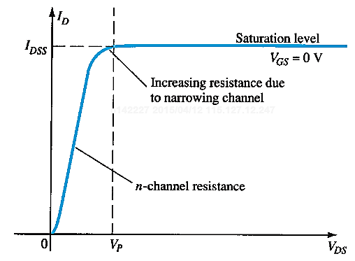


JFET Operating Characteristics: Pinch Off
If V_{GS} = 0 and V_{DS} is further increased to a more positive voltage, then the depletion zone gets so large and touch each other that it pinches off the n-channel.
This suggests that the current in the n-channel (I_{D}) would drop to 0A, but it does just the opposite–as V_{DS} increases, so does I_{D}.
Once pinch off occurs, further increases in V_{DS} do not cause I_{D} to increase.
At the pinch-off point:
V_{GS} at pinch-off is denoted as V_{p}.
I_{D} is at saturation or maximum. It is referred to as I_{DSS}.
The ohmic value of the channel is maximum.

Slide 13
At Pinch-Off, The Channel Is Not Really Pinched Off!
The term pinch-off is a misnomer in that it suggests the current I_{D} is pinched off and drops to 0A.
However, this is hardly the case —I_{D} maintains a saturation level defined as I_{DSS}
In reality, a very small channel still exists, with a current of very high density.
Why zero I_{D} is not possible at pinch-off? The absence of a drain current would remove the possibility of different potentials along the n-channel to establish the varying levels of reverse bias along the p–n junction.
The result would be a loss of the depletion region
distribution that caused pinch-off in the first place.

Slide 14
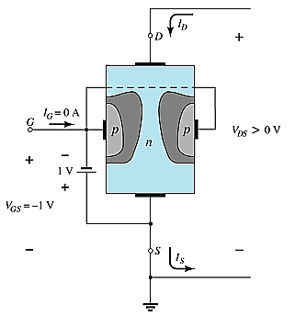
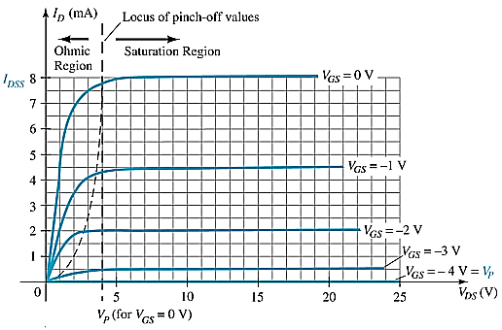
JFET Operating Characteristics, V_{GS} < 0 V (negative),
As V_{GS} becomes more negative, the depletion region begins to increase reducing the overall effective area of the channel and thus reducing the current flowing through it.
As V_{GS} becomes more negative:
The JFET experiences pinch-off at a lower voltage (V_{P}).
I_{D} decreases (I_{D} < I_{DSS}) even though V_{DS} is increased.
Eventually I_{D} reaches 0 A. V_{GS} at this point is called V_{p} or V_{GS(off)}.
Also note that at high levels of V_{DS} the JFET reaches a breakdown situation. I_{D} increases uncontrollably if V_{DS} > V_{DSmax}.

Slide 15
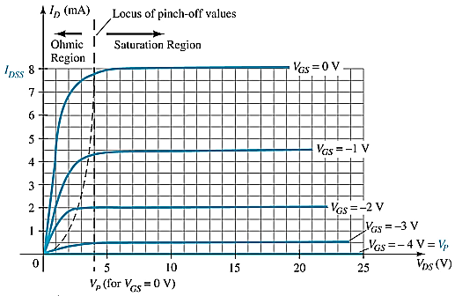
JFET Operating Characteristics: Voltage-Controlled Resistor
The region to the left of the pinch-off point is called the ohmic region.
The JFET can be used as a variable resistor, where V_{GS} controls the drain-source resistance (r_{d}). As V_{GS} becomes more negative, the resistance (r_{d}) increases.

Slide 16
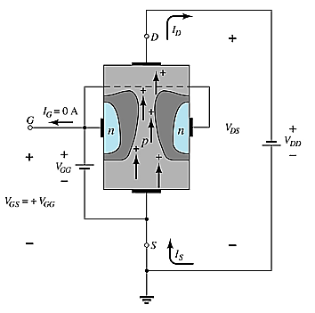
p-Channel JFETS
The p-channel JFET behaves the same as the n- channel JFET.
The only differences are that the voltage polarities and current directions are reversed.

Slide 17
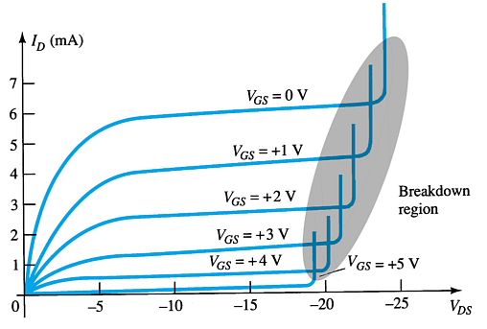
p-Channel JFET Characteristics
As V_{GS} increases more positively
The depletion zone increases
I_{D} decreases (I_{D} < I_{DSS})
Eventually I_{D} = 0 A
Also note that at high levels of V_{DS} the JFET reaches a breakdown situation: I_{D} increases uncontrollably if V_{DS} > V_{DSmax}.

Slide 18
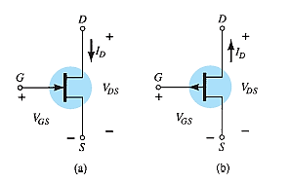
JFET Symbol
JFET symbols: (a) n-channel; (b) p-channel.

Slide 19
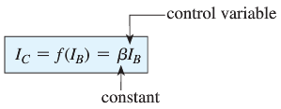
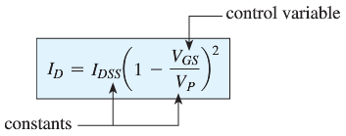
JFET Transfer Characteristics
JFET input-to-output transfer characteristics are not as straightforward as they are for a BJT.
BJT: β indicates the relationship between I_{B} (input) and I_{C}
(output).
JFET: The relationship of V_{GS} (input) and I_{D} (output) is a little more complicated:

Slide 20
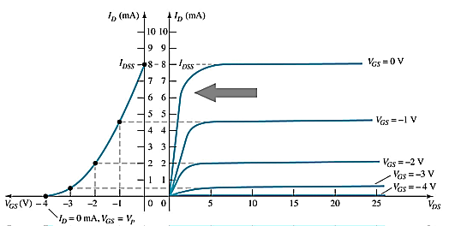
JFET Transfer Curve (Transconductance curve)
This graph shows the value of I_{D} for a given value of V_{GS}.
Using I_{DSS} and V_{p} (V_{GS(off)}) values found in a specification sheet, the transfer curve can be plotted according to these three steps:
Step 1
Solving for V_{GS} = 0V I_{D} = I_{DSS}
Step 2
Solving for V_{GS} = V_{p} (V_{GS(off)}) I_{D} = 0A
Step 3
Solving for V_{GS} = 0V to V_{p}

Slide 21
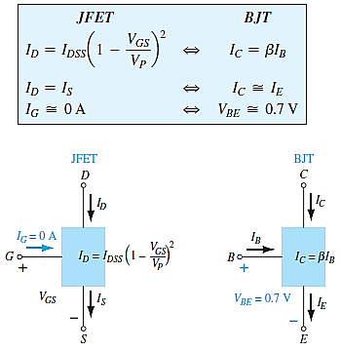





Equations in active region
$I_{D}=$drain current
$I_{C}=$Collector current
$I_{S}=$Source current
$I_{E}=$Emitter current
$I_{DSS}$is the maximum drain current for a JFET and is defined by the conditions $V_{GS}=0 V$ and $V_{DG}≥|V_{P}|$.

Slide 22
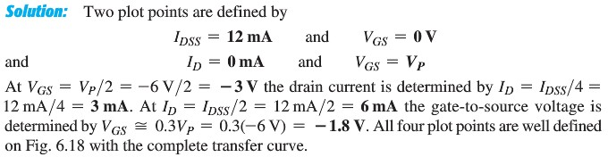
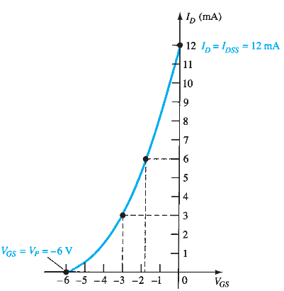

Slide 23


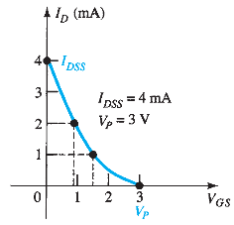

Slide 24
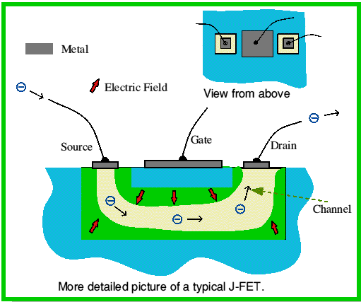
Integrated Circuit Operational View of An N-Channel JFET

Slide 25
MOSFETs
MOSFETs have characteristics similar to JFETs and additional characteristics that make then very useful.
There are two types of MOSFETs:
Depletion-Type
Enhancement-Type

Slide 26
Introduction
note: MOSFET is more widely used in implementation of modern electronic devices
Q: What are two major types of three-terminal semiconductor devices?
metal-oxide-semiconductor field-effect transistor (MOSFET)
bipolar junction transistor (BJT)
Q: Why are MOSFET’s more widely used?
size (smaller)
ease of manufacture
lesser power utilization
MOSFET technology
It allows placement of approximately 2 billion transistors on a single IC
backbone of very large scale integration (VLSI)
It is considered preferable to BJT technology for many applications.
Notes:
Note that MOSFETs are more recent development than Bipolar transistors.
Bipolar transistors were just beginning to be covered in EE curricula when I was in school (early 1960’s).
There was no mention of MOSFETS in that period.

Slide 27
Depletion-Type MOSFET Construction
The Drain (D) and Source (S) connect to the to n-type regions.
The n-typed regions are connected via an n-channel.
The n-channel is connected to the Gate (G) via a thin insulating layer of silicon dioxide (SiO₂).
The n-type material lies on a p-type substrate that may have an additional terminal connection called the
Substrate (SS).

Slide 28
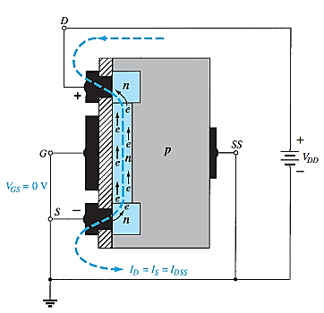
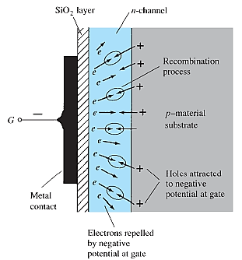
Basic Operation and Characteristics
Figure: n-Channel depletion-type MOSFET with V_{GS} = 0 V and applied voltage V_{DD}.
Figure: Reduction in free carriers in a channel due to a negative potential at the gate terminal.

Slide 29
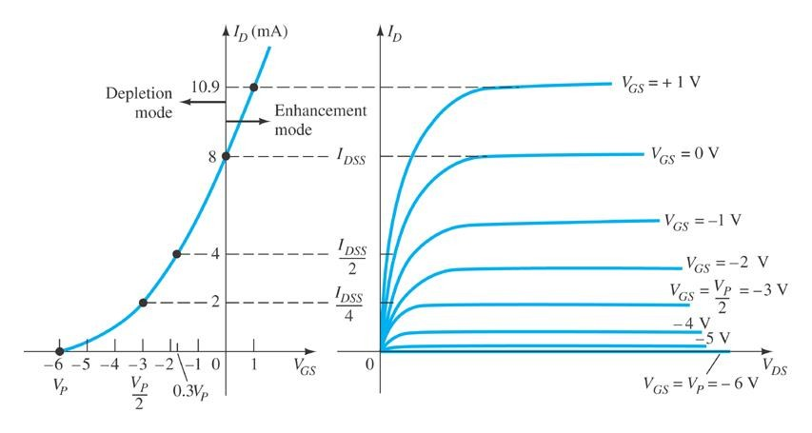
Basic MOSFET Operation
A depletion-type MOSFET can operate in two modes:
Depletion and Enhancement modes

Slide 30
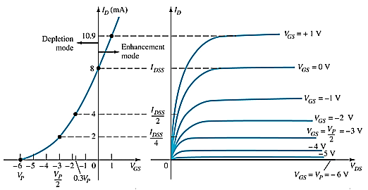
D-Type MOSFET in Depletion Mode
Depletion Mode: The characteristics are similar to a JFET.
When V_{GS} = 0 V, I_{D} = I_{DSS}
When V_{GS} < 0 V, I_{D} < I_{DSS}
The formula used to plot the transfer curve still applies:

Slide 31
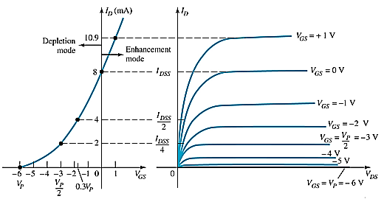
D-Type MOSFET in Enhancement Mode
Enhancement Mode:
V_{GS} > 0 V
I_{D} increases above I_{DSS}
The formula used to plot the transfer curve still applies:
Note that V_{GS} is now a positive polarity

Slide 32

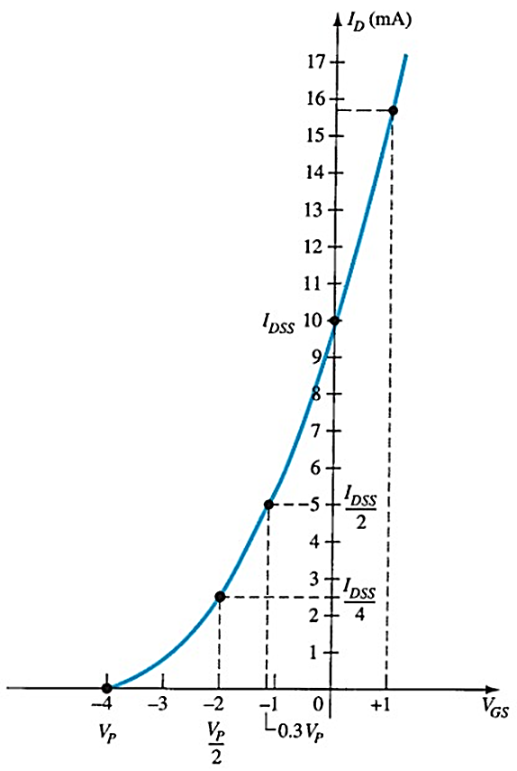


Slide 33
p-Channel D-Type MOSFET

Slide 34
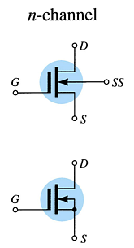
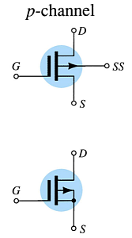
D-Type MOSFET Symbols

Slide 35
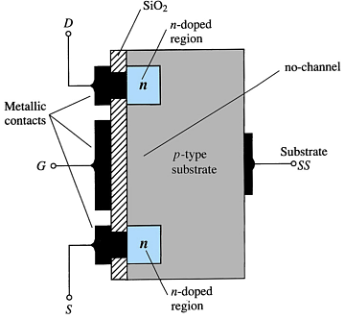
E-Type MOSFET Construction
The Drain (D) and Source (S) connect to the to n-type regions.
The Gate (G) connects to the p-type substrate via a thin insulating layer of silicon dioxide (SiO2)
There is no channel!
The n-type material lies on a p-type substrate that may have an additional terminal connection called the Substrate (SS)

Slide 36
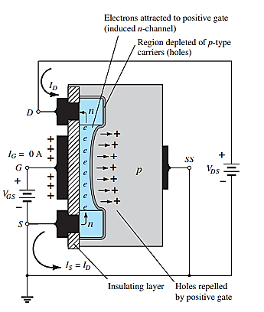
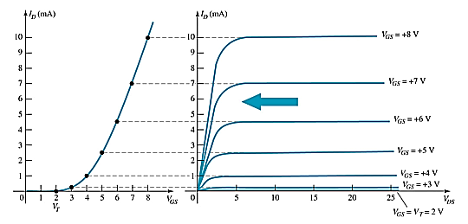
Basic Operation of the E-Type MOSFET
The enhancement-type MOSFET operates only in the enhancement mode.
V_{GS} is always positive
As V_{GS} increases, I_{D} increases
As V_{GS} is kept constant and V_{DS} is increased, then I_{D} saturates (I_{DSS}) and the saturation level, V_{DSsat} is reached
36

Slide 37
E-Type MOSFET Transfer Curve
To determine I_{D} given V_{GS}:
Where:
V_{T} = threshold voltage or voltage at which the MOSFET turns on
k, a constant, can be determined by using values at a specific point and the formula:
V_{DSsat} can be calculated by:
37

Slide 38
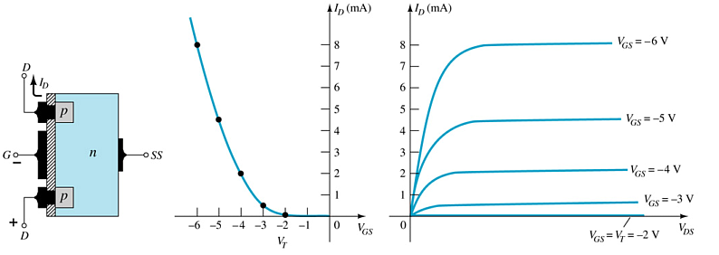
p-Channel E-Type MOSFETs
The p-channel enhancement-type MOSFET is similar to the n-channel, except that the voltage polarities and current directions are reversed.
38

Slide 39
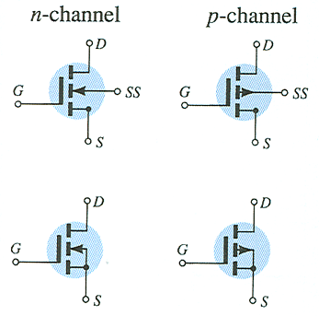
MOSFET Symbols
39

Slide 40
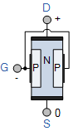
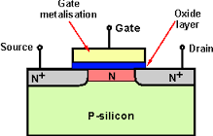
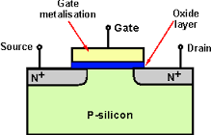
Difference between JFET & MOSFET
D-MOSFET
Depletion type
E-MOSFET
Enhancement type
J-FET
The key difference between JFET and MOSFET is that the gate terminal in MOSFET is insulated from the channel. Because of this insulated gate, the input impedance of a MOSFET is many times higher than that of a JFET.

Slide 41
VMOS Devices
VMOS (vertical MOSFET) increases the surface area of the device.
Advantages
VMOS devices handle higher currents by providing more surface area to dissipate the heat.
VMOS devices also have faster switching times.
41

Slide 42
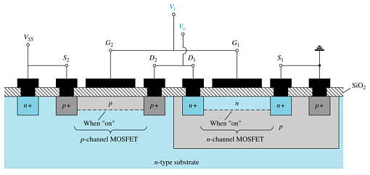
CMOS Devices
CMOS (complementary MOSFET) uses a p-channel and n-channel MOSFET; often on the same substrate as shown here.
Advantages
Useful in logic circuit designs
Higher input impedance
Faster switching speeds
Lower operating power levels
42

